Slide 1
SOCIAL MEDIA ANALYTICS DASHBOARD
Presented by: VISHAL KABILAN K
Tool Used: Microsoft Power BI
Features:
Interactive Dashboard
Dynamic Filters
Bookmarks
Navigations
DAX

Slide 2
Objectives
To analyze and visualize social media platform performance using interactive Power BI dashboard
Dashboard helps to analyze:
• Downloads performance by platform • Followers, likes, shares, and comments engagement • Platform comparison and performance trends • Regional, city, and gender-based analysis • Average and total performance using toggle feature • Dynamic filtering and interactive data exploration

Slide 3
Tools and Technologies Used
TOOLS USED:
• Microsoft Power BI Desktop • Power Query Editor
POWER BI FEATURES USED:
• Interactive Visualizations • KPI Cards • Slicers and Filters • Bookmarks and Buttons • Multi-page Dashboard
ADVANCED FEATURES:
• DAX Measures • Dynamic Image URL • Web URL Navigation • Visual Grouping and Toggle Feature

Slide 4
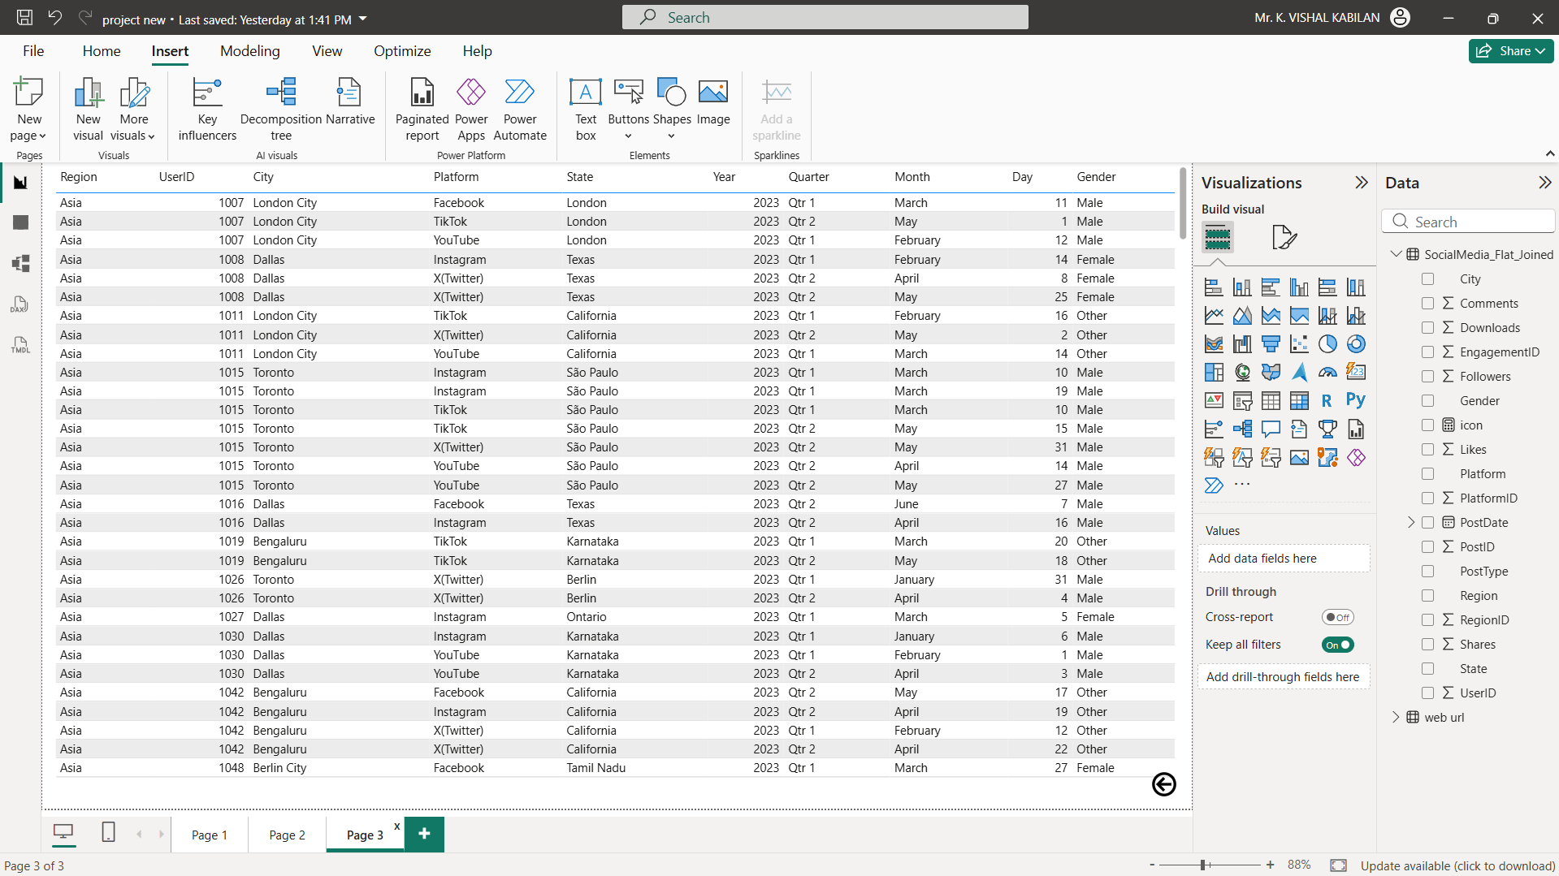
DATA SETS

Slide 5
Dataset Overview
DATASET CONTAINS:
• Platform (Facebook, Instagram, YouTube, X(Twitter), TikTok) • Region and City • State information • Gender category • Year and Month
ENGAGEMENT METRICS:
• Downloads • Followers • Likes • Shares • Comments
DATA PREPARATION:
• Data cleaned and structured in Power BI • Correct data types assigned • Used for visualization and analysis

Slide 6
Dashboard Overview – Total Performance
KEY PERFORMANCE INDICATORS (KPIs):
• Total Downloads • Total Followers • Total Shares
VISUAL ANALYSIS INCLUDES:
• Downloads by Platform comparison • Downloads and Followers by State and Gender • Downloads by City and Region • Likes distribution by Platform • Shares distribution by Platform
FEATURES:
• Interactive visualizations • Real-time filtering support • Total performance analysis using SUM view

Slide 7
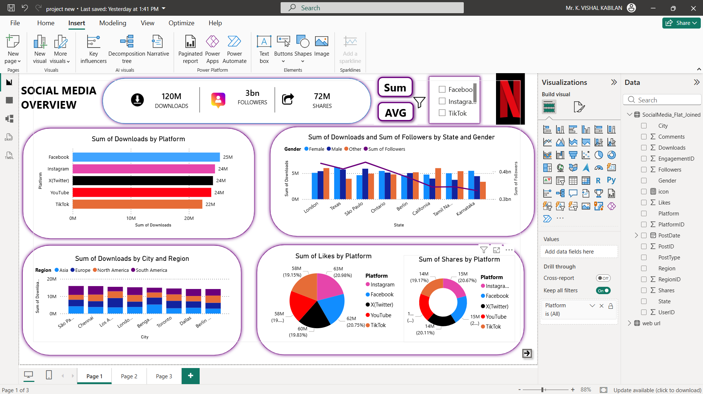

Slide 8
SUM and AVG Toggle Feature
TOGGLE FEATURE IMPLEMENTED USING BOOKMARKS
SUM VIEW:
• Displays total downloads, followers, likes, shares, and comments • Shows overall platform performance
AVG VIEW:
• Displays average engagement metrics • Shows typical platform performance
IMPLEMENTATION:
• Created using Bookmarks and Visual Grouping • Used buttons to switch between views • Provides dynamic and interactive analysis

Slide 9
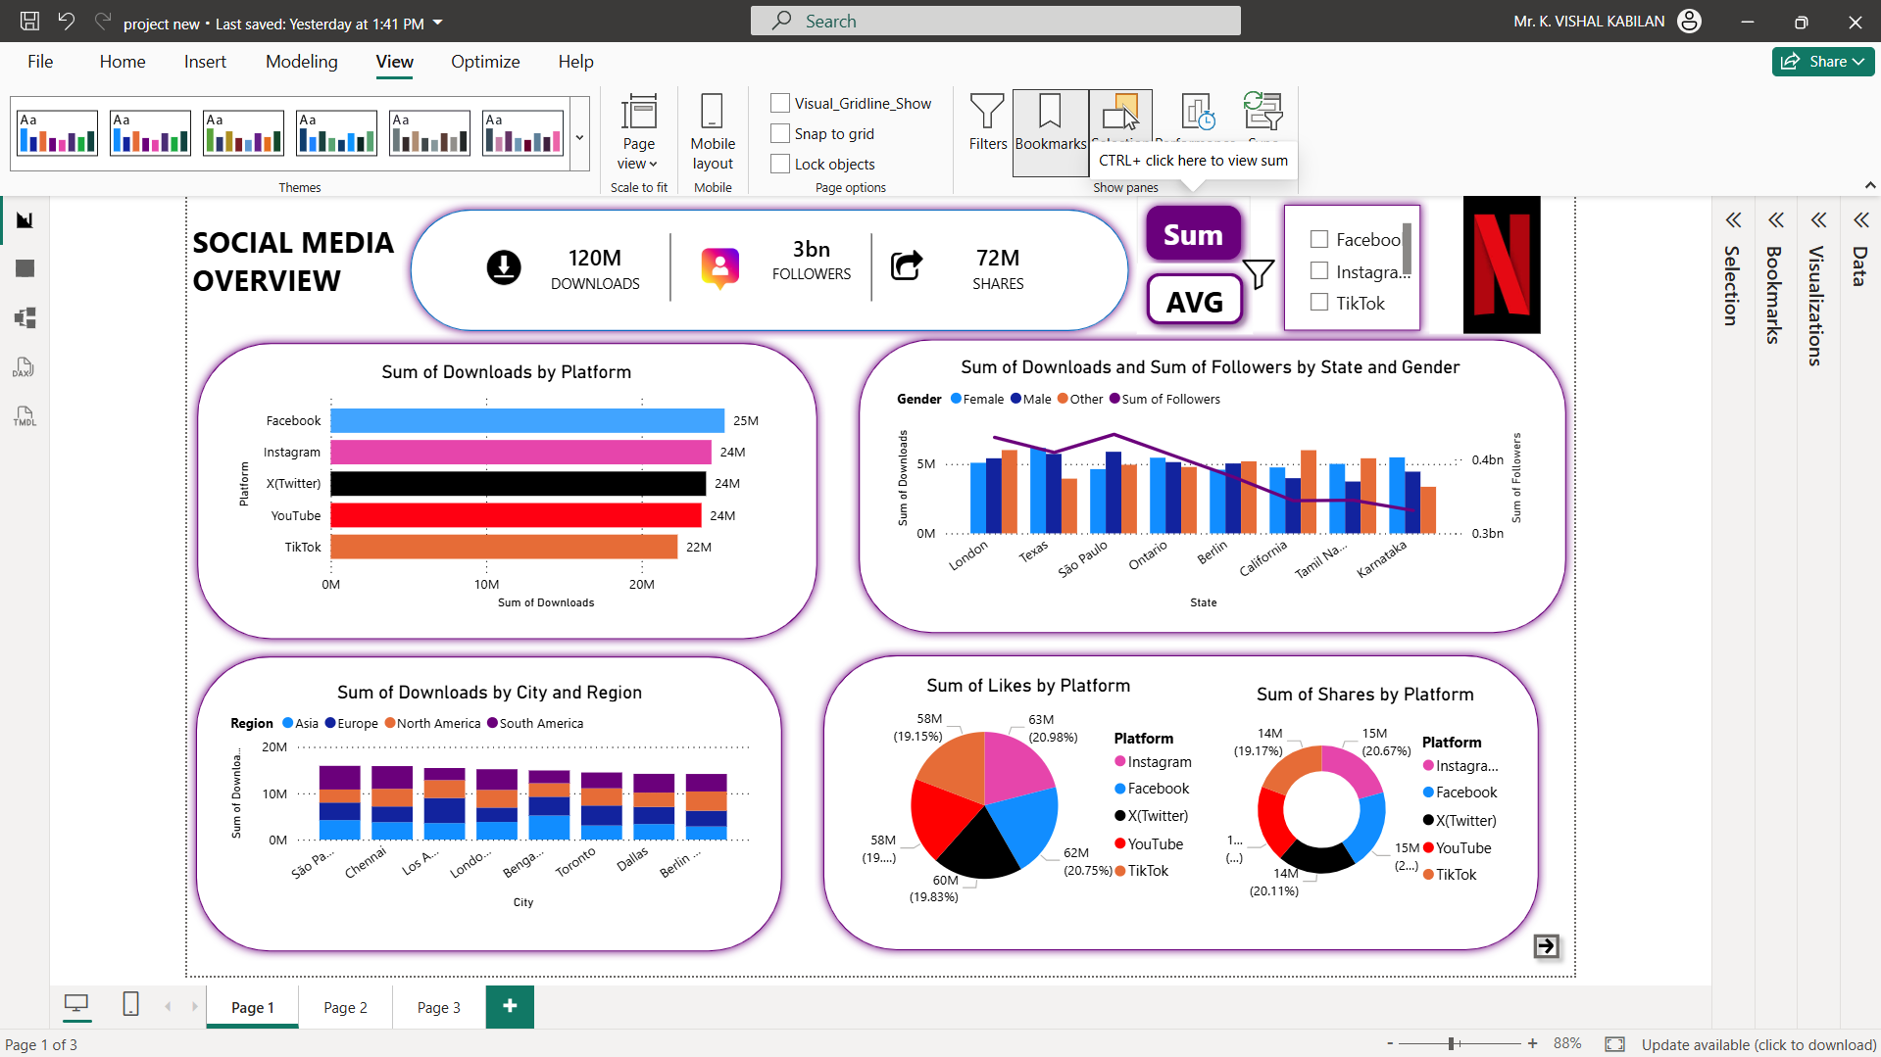

Slide 10
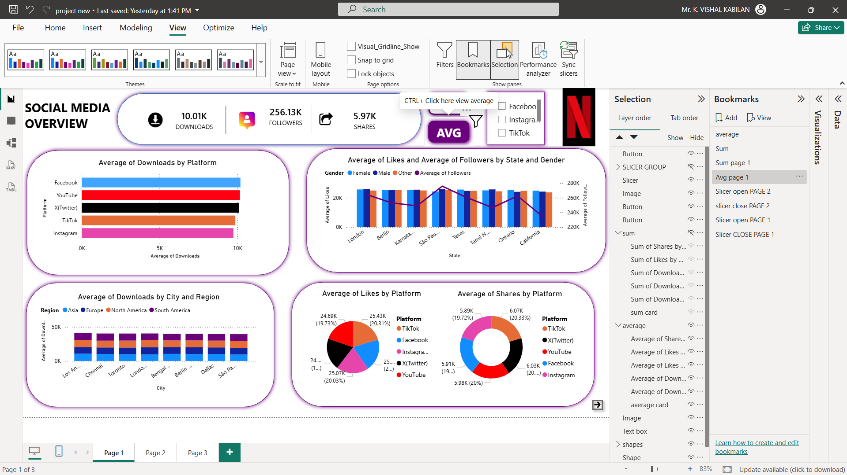

Slide 11
Interactive Filters and Slicer Panel
SLICER PANEL FEATURES:
• Platform filter • Region filter • City filter • Gender filter
FUNCTIONALITY:
• Filters all visuals dynamically • Enables focused data analysis • Improves dashboard interactivity • Created using slicers and bookmarks

Slide 12
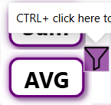
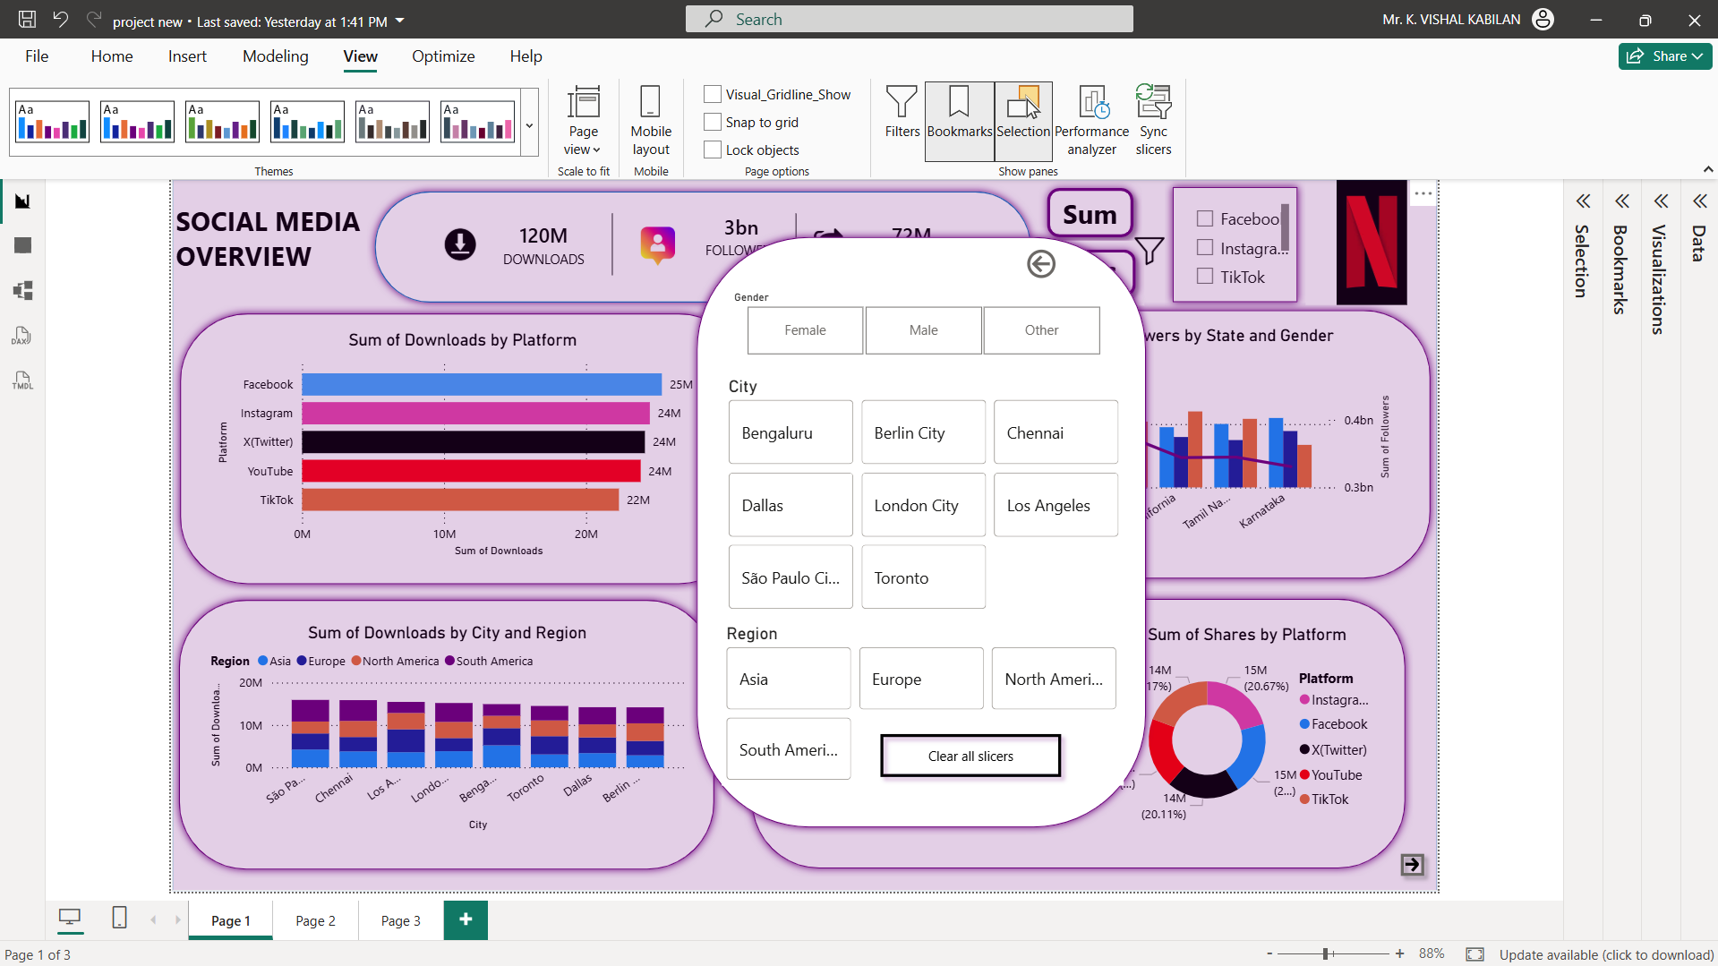

Slide 13
Dynamic Icon and Navigation Feature
DYNAMIC PLATFORM ICON:
• Platform icon changes based on selected platform • Improves visual identification • Created using DAX measure and image URL
NAVIGATION FEATURE:
• CTRL + Click on icon redirects to platform website • Dynamic URL linking based on selected platform • Implemented using DAX and Web URL action
BENEFITS:
• Improves user experience • Provides quick access to platform pages • Enhances dashboard interactivity

Slide 14
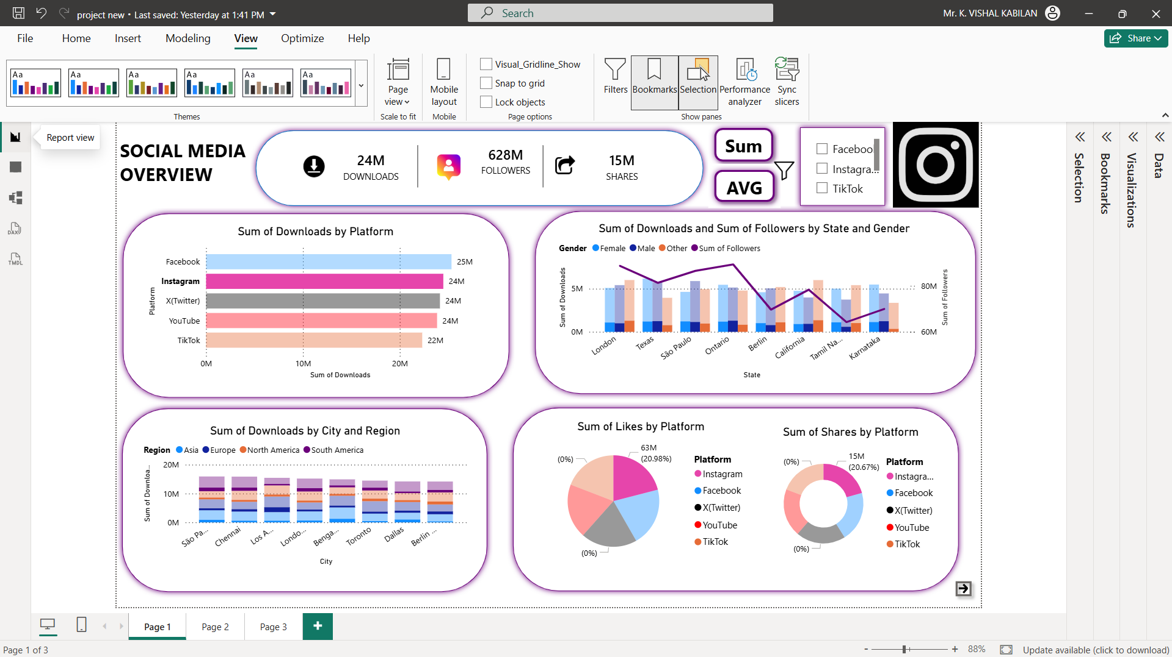
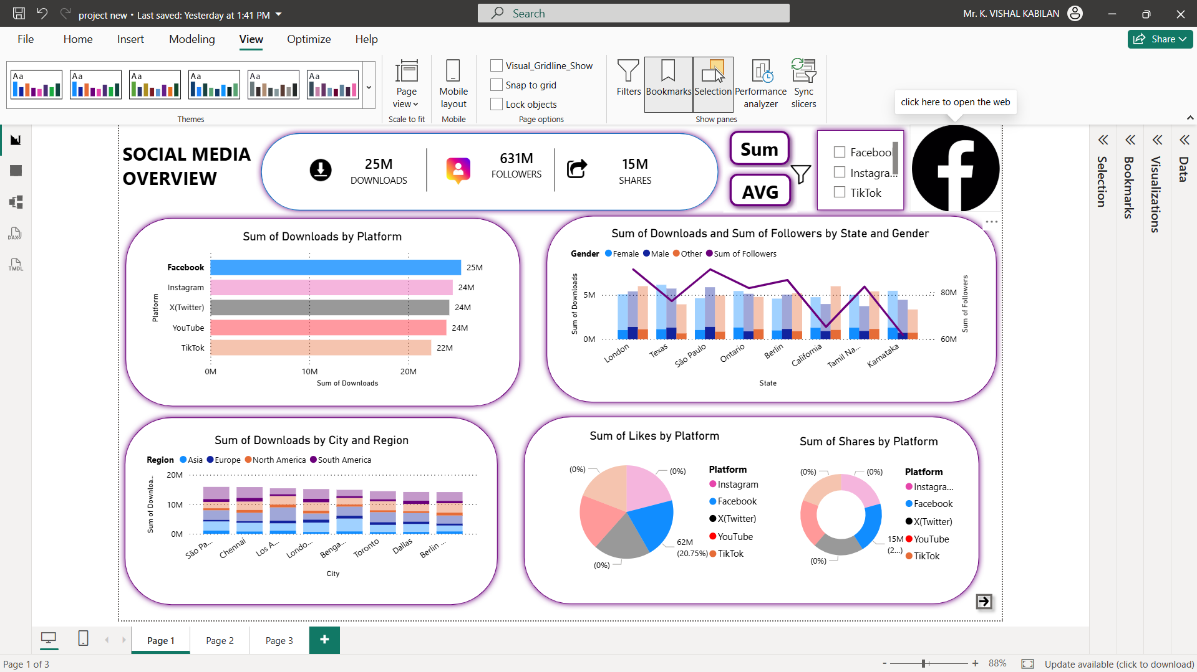
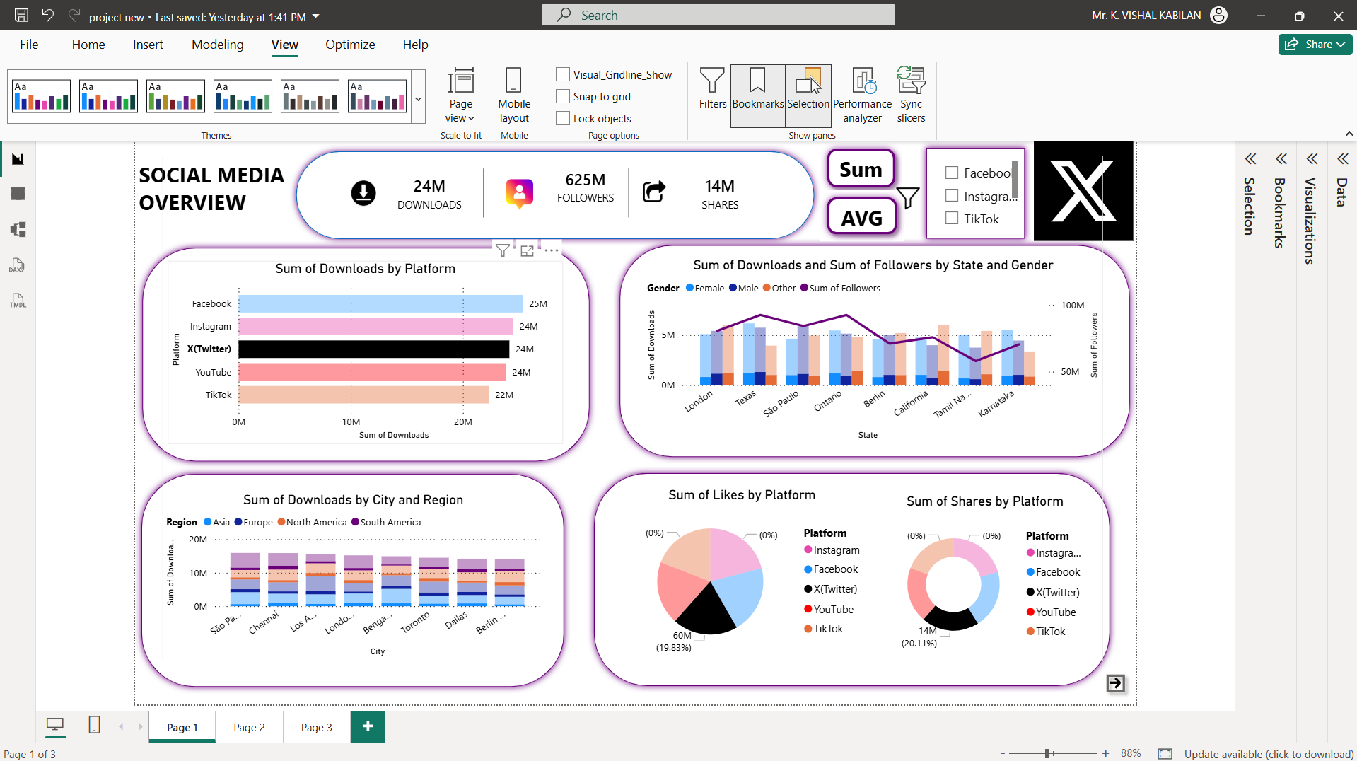
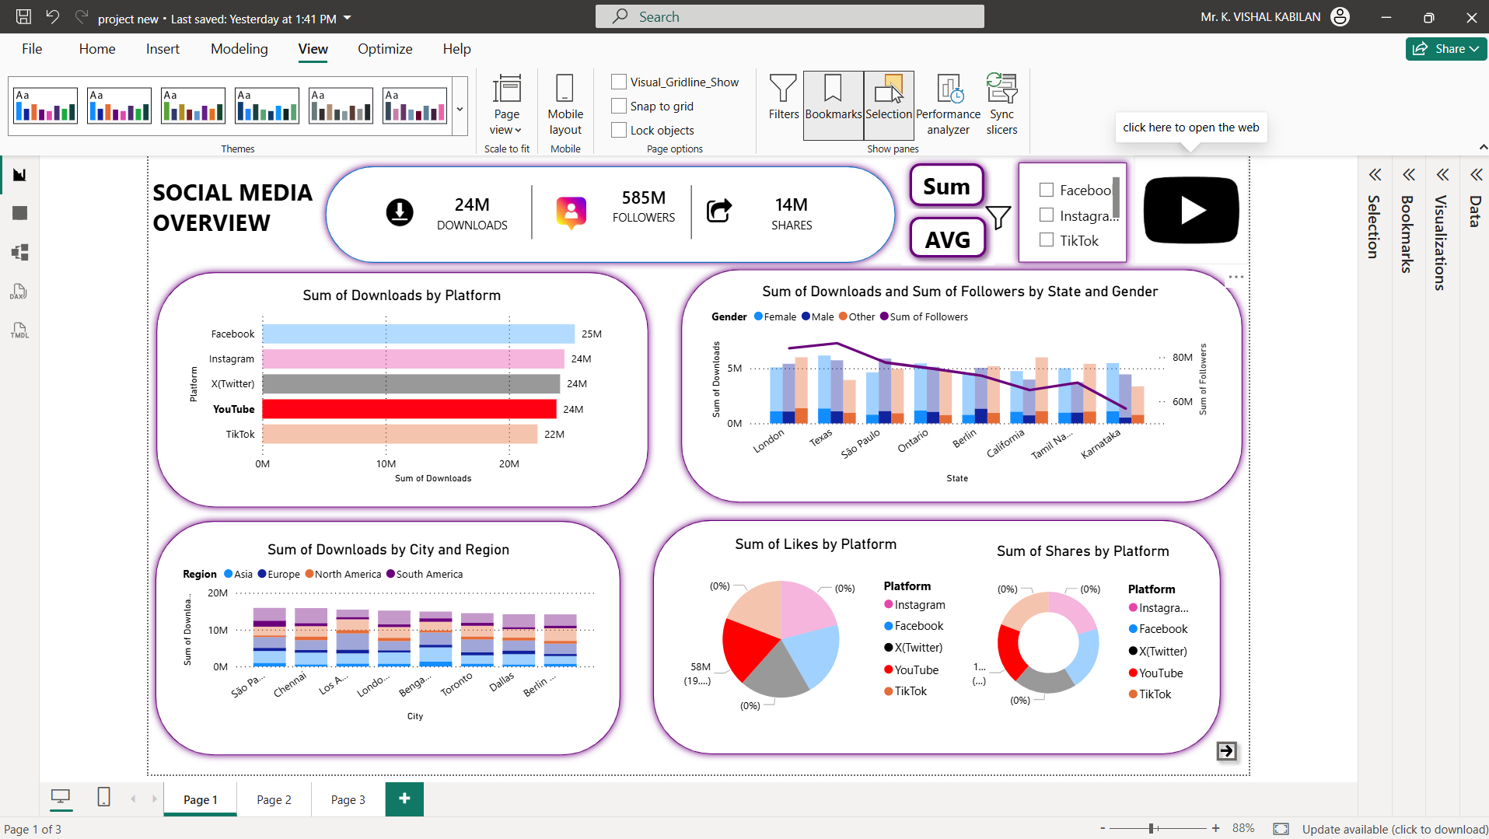

Slide 15
Advanced Analytics Dashboard (Page 2)
ADVANCED VISUAL ANALYSIS:
• Likes, Shares, and Comments by Platform and Gender • Likes analysis by Region and Platform • Followers and Shares comparison by Platform • Downloads analysis by Platform and Region
FEATURES:
• Detailed engagement analysis • Platform performance comparison • Interactive filtering support • Multi-page dashboard navigation

Slide 16
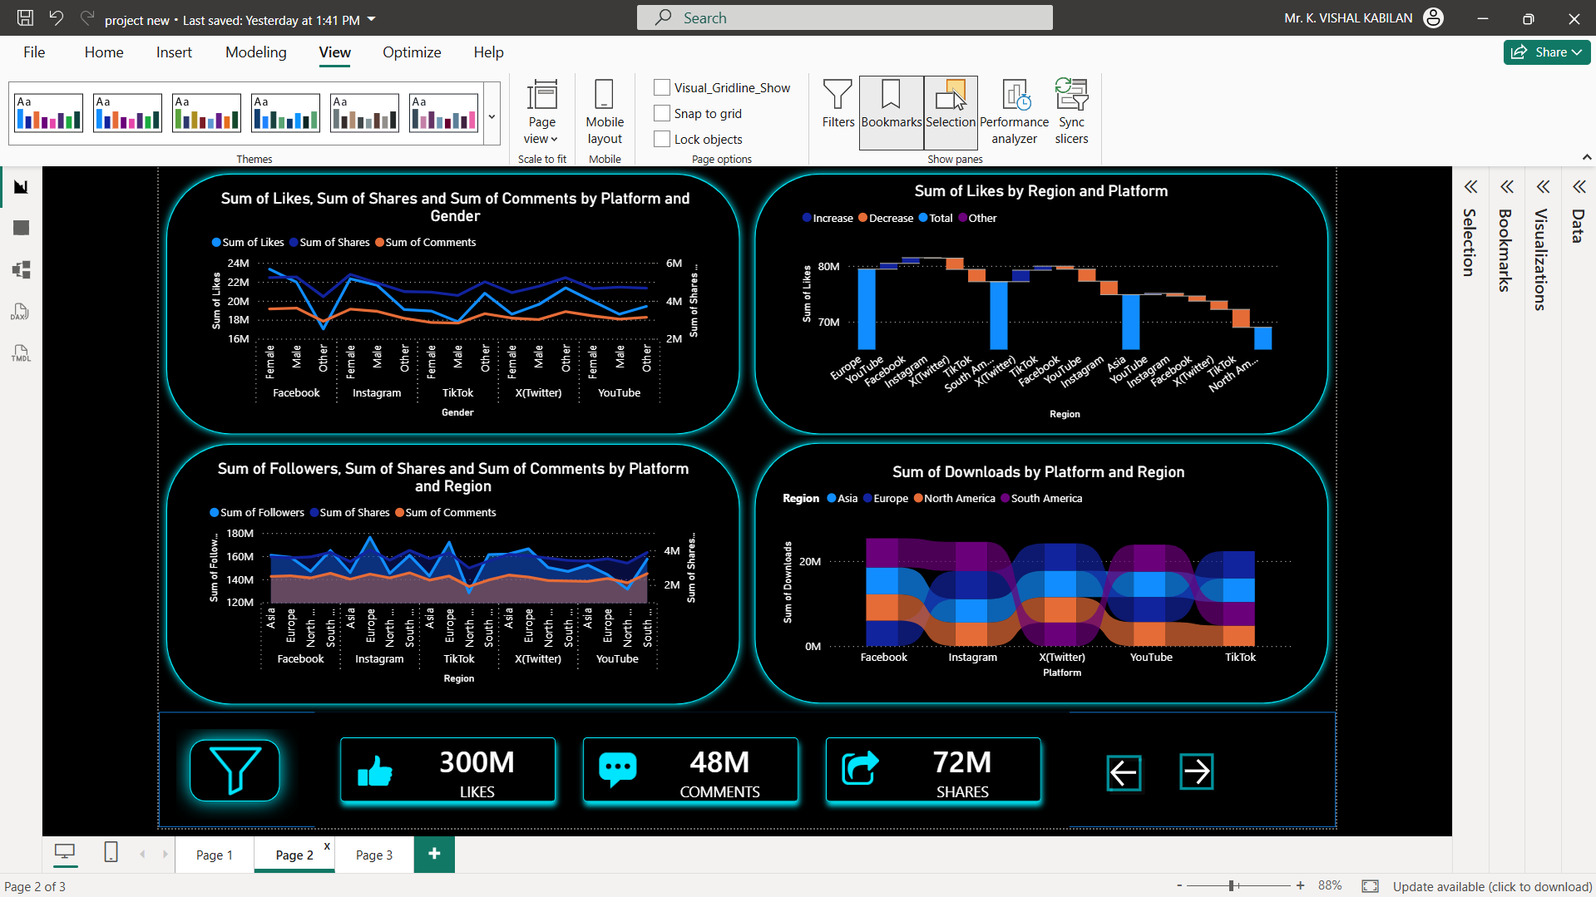

Slide 17
Page 2 – Interactive Filters and Slicers
SLICERS:
• Platform filter • Region filter • Gender filter • Additional engagement-based filtering
FUNCTIONALITY:
• Filters Page 2 visualizations dynamically • Enables detailed engagement analysis • Supports platform-specific insights • Improves user interaction and flexibility
IMPLEMENTATION:
• Created using Power BI slicers • Integrated with visual interactions

Slide 18
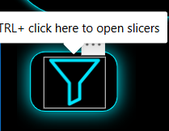
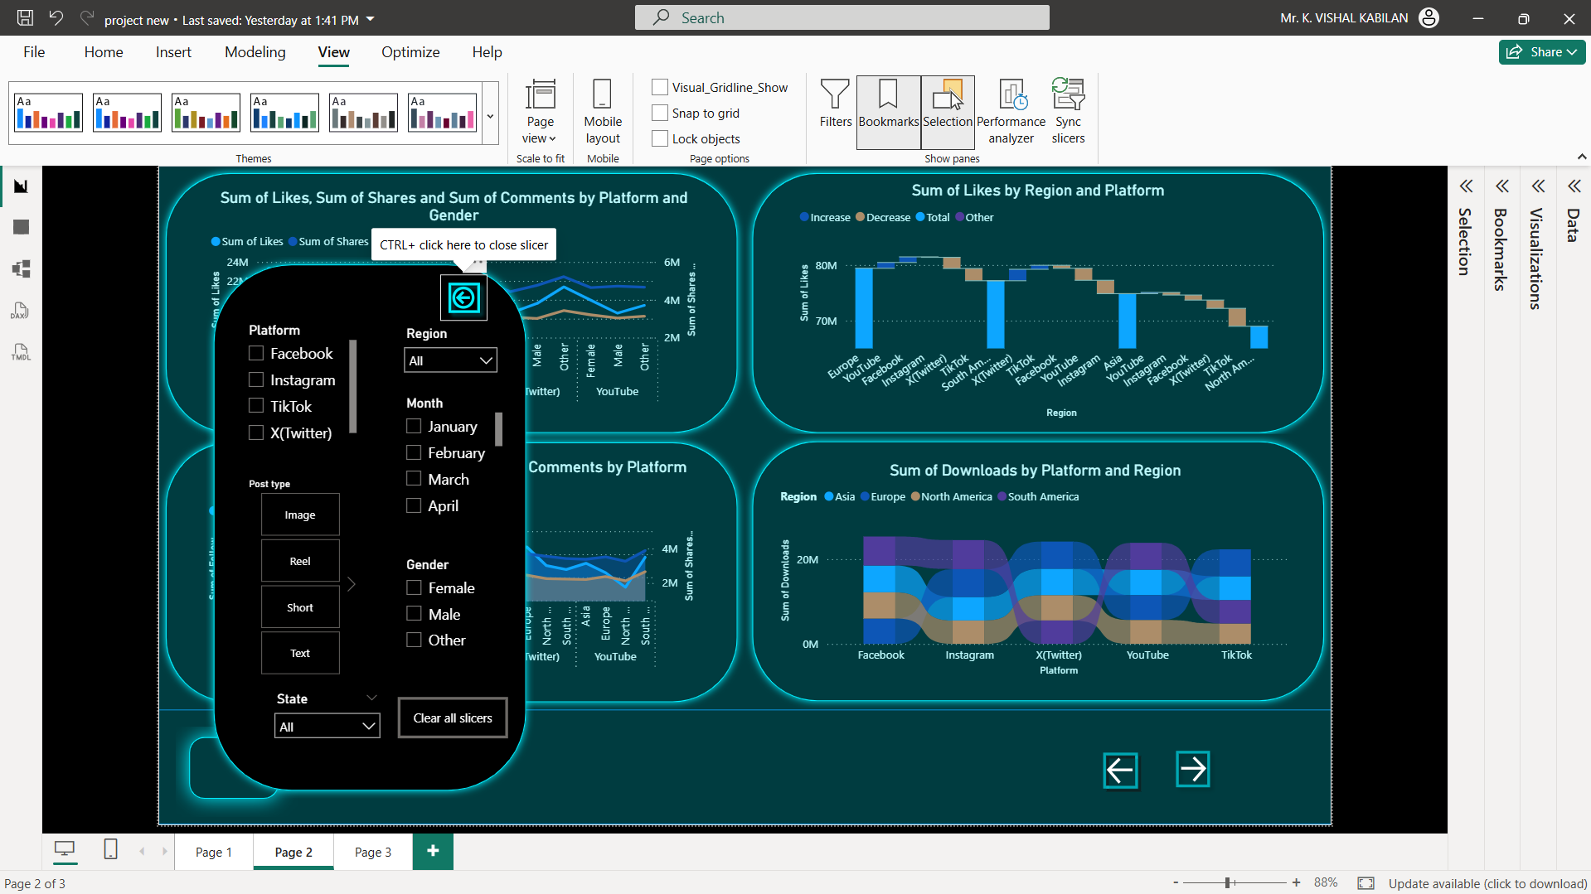

Slide 19
Navigation and Hover Feature
NAVIGATION IMPLEMENTATION:
• Navigation created using Power BI buttons • Used for switching between dashboard pages • Implemented using bookmarks and page navigation
HOVER EFFECT FEATURE:
• Button appearance changes on mouse hover • Provides visual feedback to the user • Improves dashboard interactivity • Enhances user experience

Slide 20
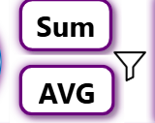
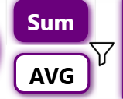

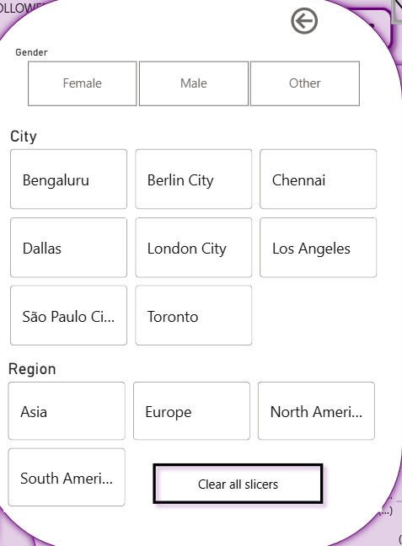
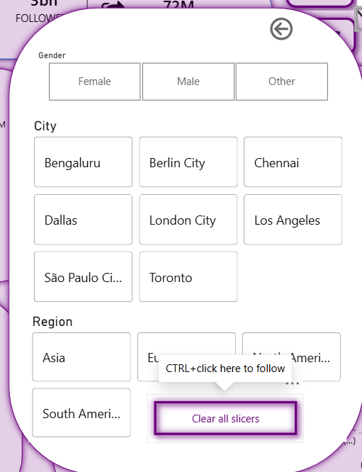

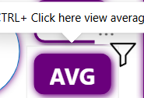

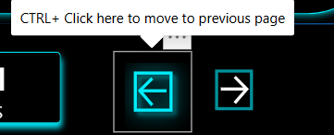
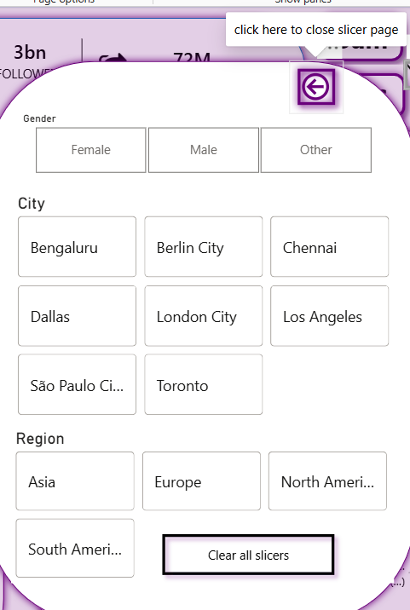
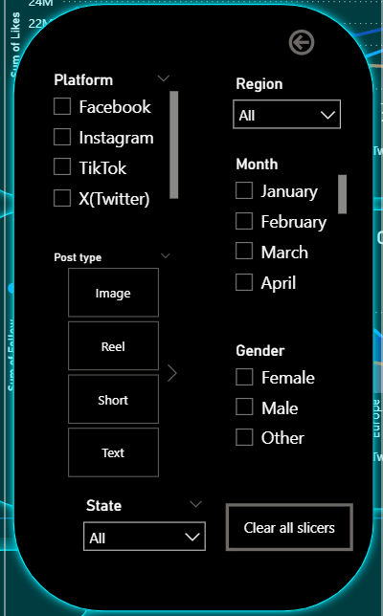
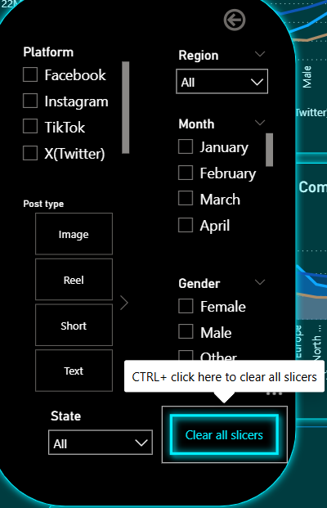
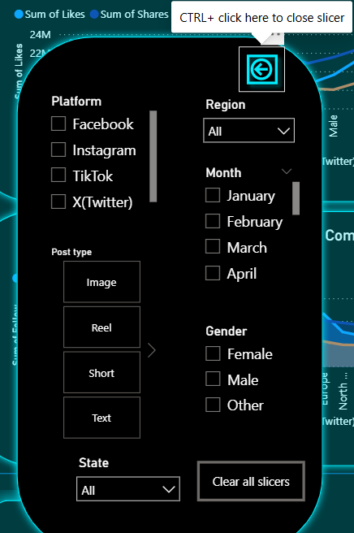

Slide 21
Conclusion
PROJECT SUMMARY:
• Developed Social Media Analytics Dashboard using Microsoft Power BI • Visualized downloads, followers, likes, shares, and comments • Compared performance across multiple social media platforms
KEY FEATURES IMPLEMENTED:
• Interactive filters and slicer panels • SUM and AVG toggle using bookmarks • Dynamic platform icon and web navigation • Multi-page dashboard with advanced analysis
OUTCOME:
• Provides clear and interactive data visualization • Helps analyze platform performance effectively • Supports data-driven decision making

Slide 22
THANK YOU
THANK YOU

